Slide 1
K Nearest Neighbour
Abhijit Ramesh Patil

Slide 2
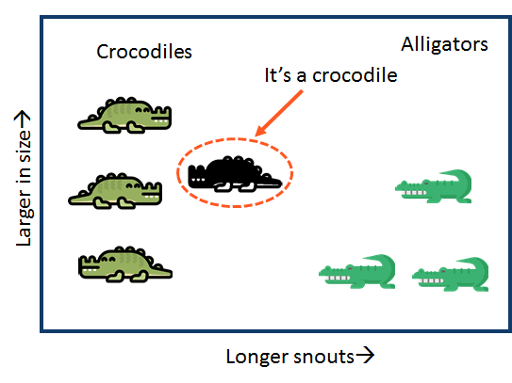
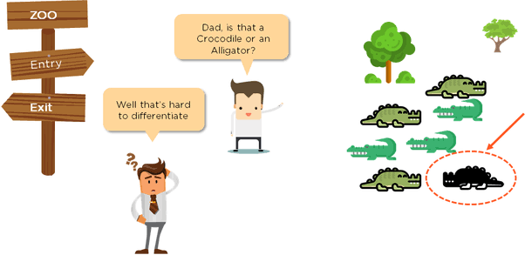
What is KNN algorithm ?
KNN is supervised learning algorithm used in machine learning for classifying the data set into known classes.
The learning is based on how similar is a data from other.
It stores all available cases and classifies new cases based on similarity.

Slide 3
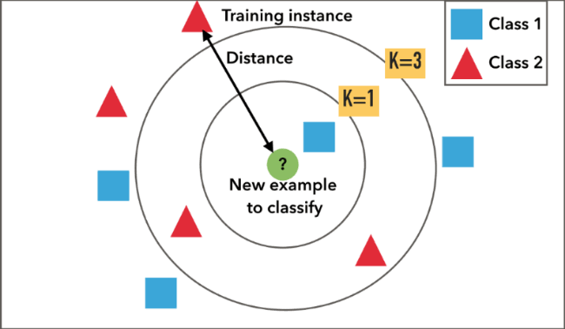
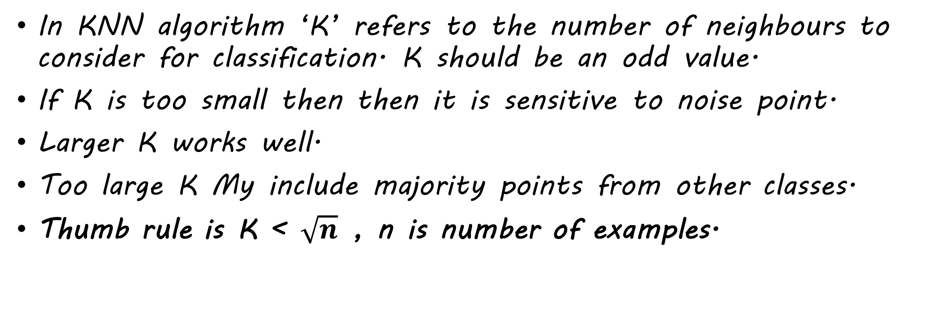
What is K in KNN ?
In KNN algorithm ‘K’ refers to the number of neighbours to consider for classification. K should be an odd value.
If K is too small then then it is sensitive to noise point.
Larger K works well.
Too large K My include majority points from other classes.
Thumb rule is K < $\sqrt{n}$ , n is number of examples.

Slide 4
What are steps in KNN ?
Step 1 : Choose value for K (K should be an odd number).
Step 2: Find the distance of two point to each of the training data.
Step 3: Find the K nearest neighbours to the new data points.
Step 4: Classification of new data point into category class.

Slide 5
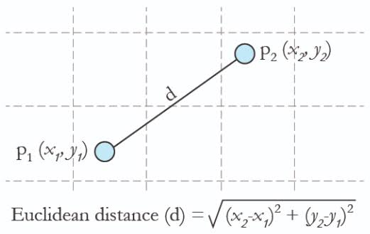

How is the distance calculated in KNN ?
In KNN distance can be calculated by 2 methods
1)Euclidean distance
It is the square root of sum of squared distance between two points.
Dist. = $\sqrt{\text{(}\text{x}\text{2}\text{ – }\text{x}\text{1}\text{)}\text{2}\text{ + (}\text{y}\text{2}\text{ – }\text{y}\text{1}\text{)}\text{2} }$

Slide 6
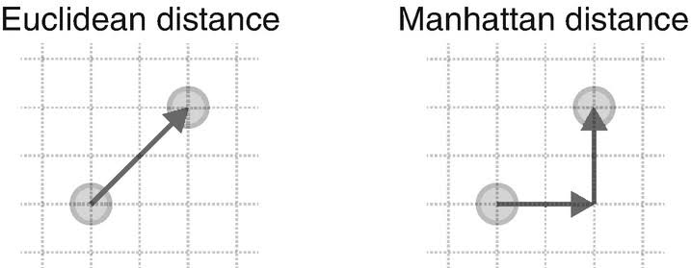
2)Manhattan distance
It is the sum of the absolute values of the differences between two points.
Dist. = |x1 - x2| + |y1 - y2|

Slide 7
